Slide 1
Terraform Intermediate Level Training

Slide 2
Introduction

Slide 3
Introduction
What’s this training all about?
Follow on from Terraform 101 training which covers basic concepts
Directed at individuals with intermediate level experience
Attempts to cover topics relevant to project work
Also touch on topics required for certification exam
Lab repository located at:
git@github.com:AHEAD-Labs/terraform-training-intermediate.git

Slide 4
Terraform Training Agenda
Command line
Style Guide
Modules
Remote State
Build-in Functions
Loops and Conditionals

Slide 5
Agenda
8:00 – 8:15 | Class Intro
8:15 – 8:45 | Terraform Command Line Lesson and Lab
8:45 – 9:45 | Modules Lesson and Lab
9:45 – 10:00 | Break
10:00 – 10:15 | Style Guide Lesson
10:15 – 11:00 | Remote State Management Lesson and Lab
11:00 – 11:30 | Built-In Functions and Lab
11:30 – 12:00 | Loops and Conditionals

Slide 6
Terraform Command Line

Slide 7
Command Line
Everyone should be familiar with most important Terraform subcommands beyond init/plan/apply. Example:-
show
state
taint / untaint
import
graph
https://www.terraform.io/docs/commands/index.html
Best wait to explain these is via the lab exercise

Slide 8
Lab 1 – Terraform Command Line

Slide 9
Configuration Style Guidelines

Slide 10
Configuration Style Guidelines
File structure
Include a ‘terraform’ config block
Variable definitions
Configuration creation and formatting
Comments and README.md

Slide 11
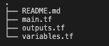
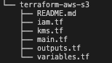
File Structure
Each configuration folder should typically contain the following files:
Not all configuration needs to reside in main.tf. Separate out where it make sense. Example of an S3 module which also requires a large number of resources for KMS and IAM

Slide 12
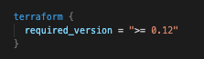
Terraform Config Block
Always a good idea to specify the terraform versions your code supports

Slide 13
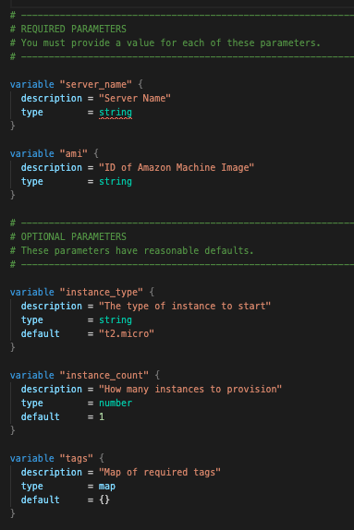
Variable Definitions
Variable definitions should include, in this order
Description
Type
Default (Optional)
Good rule of thumb to separate required variables from optional variables

Slide 14
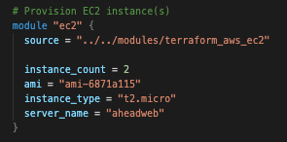
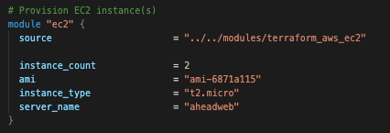
Configuration Creation and Formatting
Use underscore ’_’ instead of hyphen in configuration names
Use ‘terraform fmt’ on config files. Example :-
Before
After

Slide 15
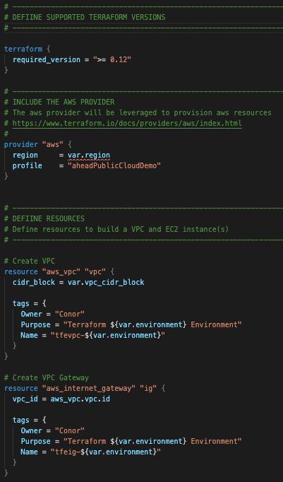
Comments and README.md
Include short comment for config blocks to give high level summary of its purpose
Provide links to providers
Some configurations are more complex that others and could use better commenting. Up to user’s digression

Slide 16
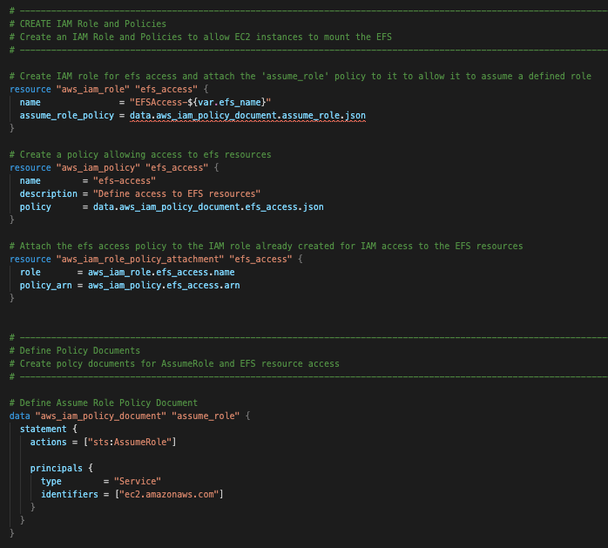
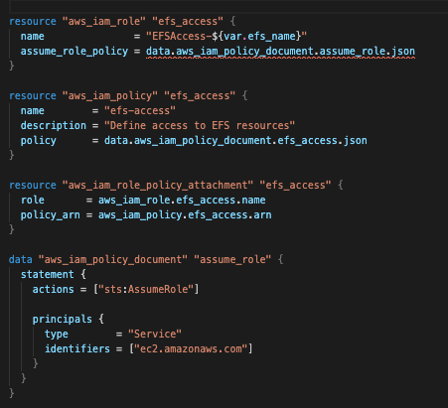
Comments and README.md (cont.)
Commented vs uncommented..

Slide 17
Modules

Slide 18
Modules
What is a Module?
A module is a container for multiple resources that are used together
Think of them along the same lines as a function in regular programming language
Every Terraform config has at least one module, known as the root module
Modules are sourced and installed during terraform init. Therefore terraform init must be re-run to pickup any updates to a module
Modules can call other modules, typically referred to as child modules
Modules are called from within other modules using module blocks
A particular module instance can be instantiated multiple times
https://www.terraform.io/docs/configuration/modules.html

Slide 19
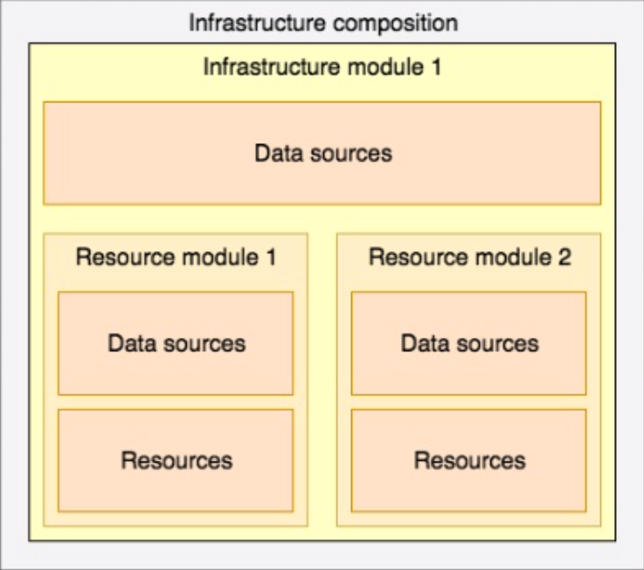
Types of Terraform Modules
Resource modules:
Create resources, e.g. an ec2 instance
Few relations to other modules (usually)
Very flexible
Infrastructure modules:
Grouping of resources which comprise an application for example
Use specific version of resource modules
Enforce Company-wide standards (e.g., tags, names, etc)
Composition:
Use specific version of infrastructure or resource modules
Provide all the values for region, environment, module, etc

Slide 20
Benefits of Using Modules
Easy way to abstract common blocks of configuration into reusable infrastructure elements, which help
Reduce duplication
Enable isolation
Enhance testability
Reduces maintenance and makes management of infrastructure more efficient
Configuration is generally easier to read and understand

Slide 21
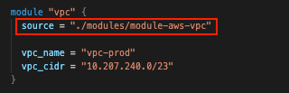
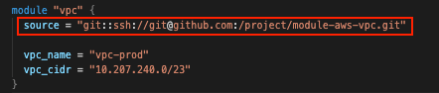
Sourcing a Module
Sourcing a local module:
Sourcing a module from a Version Control repository

Slide 22
VCS modules
Repositories should generally be private
Always recommended to use SSH over HPPTS when sourcing a module as it avoids having to pass tokens which would be necessary for authentication with HTTPS. Instead Keys can be used with SSH

Slide 23
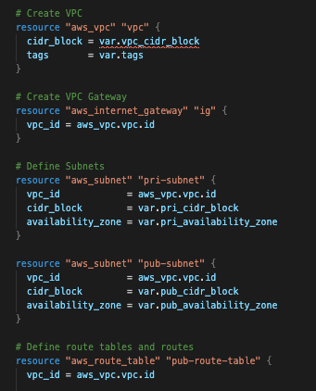
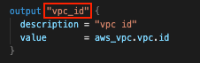
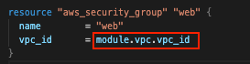
Accessing Module Output Values
Values from the child module can be accessed by the calling module by defining and exporting module outputs in the child module

Slide 24
Creating Modules – Rules of Thumb
Naming the module – terraform-<provider>-<name>
Each module should be stored in its own VCS repository
Determining inputs and outputs
Always include a README.md
Description
Usage
Inputs
Outputs
Author

Slide 25
Creating Modules – Rules of Thumb (cont.)
Separate out configuration into multiple files if it makes sense (not everything needs to be in main.tf)
Run terraform fmt at the very least before final commit
Tag modules using Symantec Version
v<major_release>.<minor_release>.<patch>
No provider references in modules!

Slide 26
Module Resources
Hashicorp’s official documentation
Modules general https://www.terraform.io/docs/configuration/modules.html
Creating modules https://www.terraform.io/docs/modules/index.html
Hashicorp’s Terraform Module Registry
https://registry.terraform.io

Slide 27
Modules Lab

Slide 28
Remote State

Slide 29
Remote State
State is stored remotely as opposed to locally which is the default
Supports working in teams
With remote state, Terraform writes the state data to a remote data store, which can then be shared between all members of a team.
Provides better security
Most backends provide encryption at rest and are highly available
Backend options
Terraform supports storing state in Terraform Enterprise, Consul, Amazon S3, Azure Blob storage and more
https://www.terraform.io/docs/backends/index.html

Slide 30
Configuring a Remote Backend
Each backend has different configuration requirements
Accessed via the terraform_remote_state data source
Read-Only access to the state file
Attributes are made available by configuring outputs for them in the states originating configuration
Let’s take a look at a couple of examples..

Slide 31
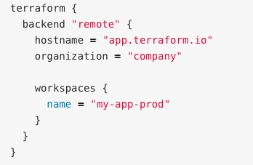
Terraform Cloud Backend
Here we access a remote state file in Terraform Cloud by providing specific information such as :-
Terraform Cloud URL
Relevant Organization
Relevant Workspace
Creds can be stored in a configuration file (terraform.rc) to avoid having to specify in the configuration

Slide 32
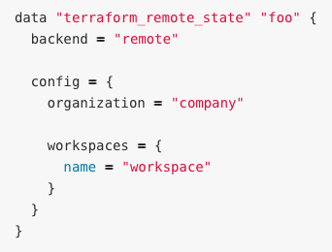
Accessing State in Terraform Cloud
Similar configuration options to the backend setup
Access a state output using the following syntax:-
data.terraform_remote_state.<name>.outputs.<output_name>

Slide 33
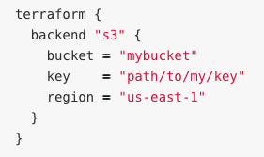
S3 Backend
Very popular option for open source users.
Prerequisites
Requires S3 bucket for state file storage
DynamoDB table for state file locking
Configuration requires
Bucket name (universally unique)
Location of state file in bucket (key)
Region
Access keys can be stored in AWS credentials file to avoid having to specify in the configuration

Slide 34
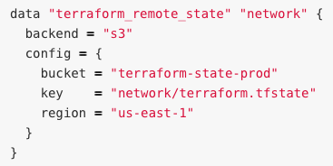
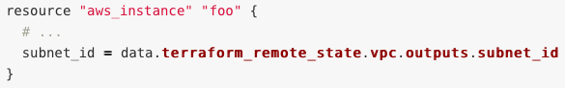
Accessing State in S3
Again, similar to the backend configuration, the remote state configuration block looks for the same information when defining it.
Example configuration using a remote state data output

Slide 35
Remote State Lab

Slide 36
Built-In Functions

Slide 37
Terraform Build-In Functions
The unsung hero of terraform configuration
Terraform does not support user-defined functions, so only the built-in functions are available for use
You can experiment with the behavior of Terraforms built-in functions from the Terraform expression console by running the terraform console command
https://www.terraform.io/docs/configuration/functions.html

Slide 38
Built-In Functions
Terraform provides close to 100 built in functions grouped into the following categories:
Numeric Functions
String Functions
Collection Functions
Encoding Functions
Filesystem Functions
Data and Time Functions
Hash and Crypto Functions
IP Network Functions
Type Conversion Functions

Slide 39
Most Popular/Useful Functions
Format
Join
Split
Element
Index
Length
Keys
Lookup
List
Contains
Values
Distinct
Zipmap
Concat
Timestamp

Slide 40
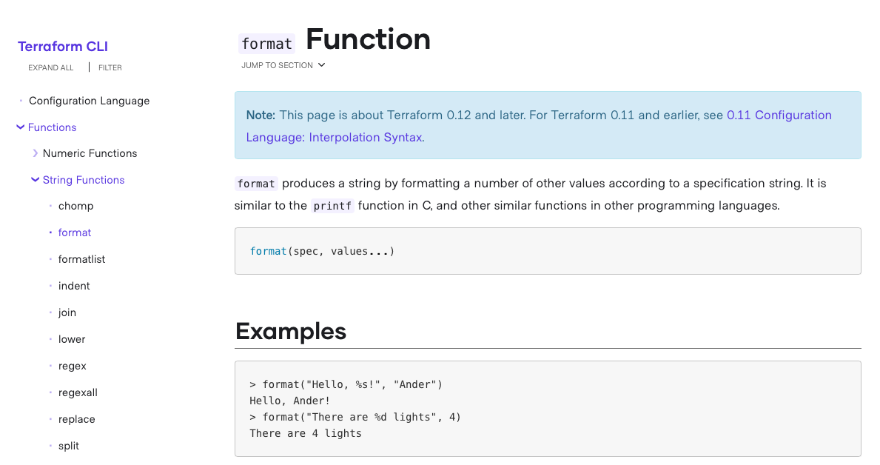
Example reference documentation

Slide 41
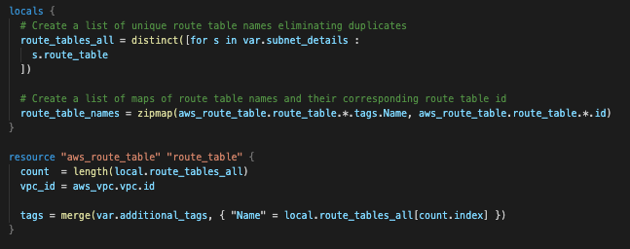
Sample Usage In Configuration

Slide 42
Built-In Functions Lab

Slide 43
Loops and Conditionals

Slide 44
Loops and Conditions
Loops
count parameter – loop over resources
for_each expression – loop over resources and inline blocks within a resource
for expression – loop over lists an maps
Conditionals
count parameter – used for conditional resources
if string directive – used for conditionals within a string

Slide 45
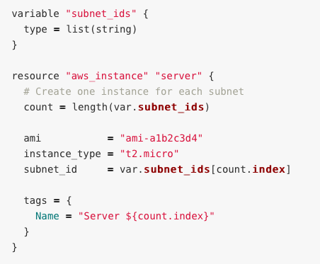
Loops : Count Parameter
The count parameter is Terraform’s oldest, simplest, and most limited construct
It simply defined how many copies of a resource you want

Slide 46
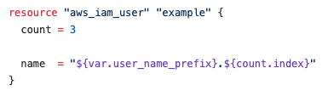
Loops : Count parameter (cont.)
The following example demonstrates the use of count’s index function which can be used to get the index of each iteration in the loop

Slide 47
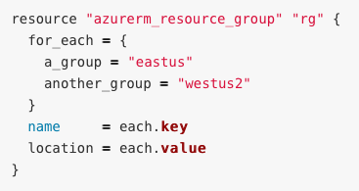
Loop : for_each Expression
Allows you to loop over lists, sets and maps to create either
Multiple copies of a resource
Multiple copies of an inline block within a resource
The each object is available in resource blocks where for_each is set

Slide 48
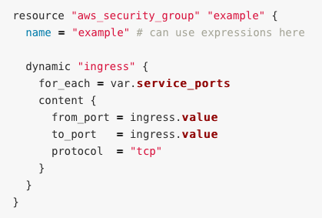
Loops : for_each (cont.)
for_each is commonly used within dynamic blocks to generate multiple copies of inline blocks

Slide 49
Loops : for_each (cont.)
NOTE:
for_each does not currently support modules
A given resource block cannot use both count and for_each
Once you use for_each on a resource it becomes a map of resources rather than an array of resources like count. This is an important advantage of using for_each over count because you can remove items (resources) from the middle of a collection safely. With count, if you remove an item (resource) from the middle of a list, Terraform will delete every resource after that item and recreate them in a new shrunken list which eliminated the empty space in the array

Slide 50
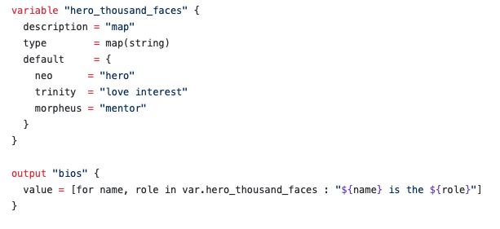
Loops : for Expression
Used for generating single values
The basic syntax is:
[for <ITEM> in <LIST> : <OUTPUT>]

Slide 51
Conditionals : Count Parameter
Terraform does not support if-statements
However, you can accomplish the same thing by using the count parameter and taking advantage of two properties:
If you set count to 1 on a resource, you get one copy of a resource. If you set count to 0, that resource is not created.
Terraform supports conditional expressions of the format
<CONDITIONAL> ? <TRUE_VAL> : <FALSE_VAL>

Slide 52
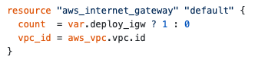
Conditionals : Count Parameter (cont.)
If the value of var.deploy_igw is True, provision on aws_internet_gateway, else don’t provision any.

Slide 53
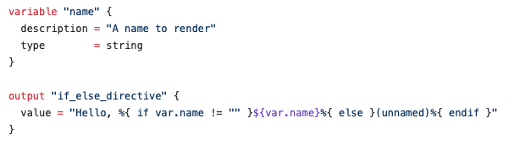
Conditionals : If String Directive
The if string directive chooses between two templates based on the value of a bool expression. It has the following form:
%{ if <CONDITION> }<TRUEVAL>%{ endif }

Slide 54
To Be Continued…
Future topics for discussion
Types
dynamic blocks
lifecycle
depends_on
Provisioners
Providers
community providers
alias
Pipeline integrations

Slide 55
And that’s a wrap..

Slide 56
Reference Material
Terraform Up & Running by Yevgeniy Brikman
https://www.terraformupandrunning.com
Hashicorp’s Terraform Documentation
https://www.terraform.io/docs/index.html
Exam Associate Certificate Exam Review
https://learn.hashicorp.com/terraform/certification/terraform-associate

